Slide 1
Camera API
Mobile Application Development
Praveen Kumar

Slide 2

What is the Camera API
The Android framework includes support for various cameras and camera features available on devices, allowing you to capture pictures and videos in your applications. This document discusses a quick, simple approach to image and video capture and outlines an advanced approach for creating custom camera experiences for your users.
Capture Photos and Videos

Slide 3
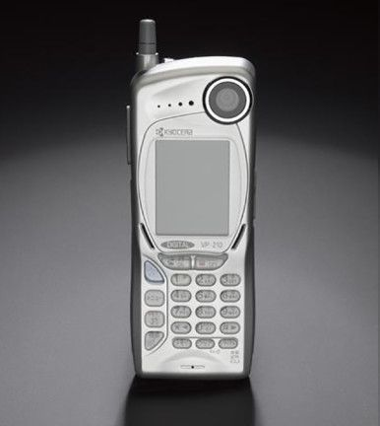
Camera API was introduces in Android along with Android version 1.0 (API 1)
Before being replaced by Camera2 API in 2014 which was launched in Android version 5.0 (API 5)

Slide 4
Permissions needed
Declare the permissions in the Android Manifest Camera Usage: android.permission.CAMERA" Camera Features: android.hardware.camera Camera Auto-Focus: android.hardware.camera.autofocus Write to External Storage: android.permission.WRITE_EXTERNAL_STORAGE

Slide 5
Camera API Overview
Primary API for controlling device cameras. Used to capture pictures and videos.
Package: android.hardware.Camera
Methods:
Camera.open() – Obtain an instance
startPreview() – Starts the Camera preview
takePicture() – Takes a picture
stopPreview() – Stops the Camera preview
release() – Releases the camera
getParameters() – Zoom, Image Quality, Location Information

Slide 6
Camera API – Features
Camera1 API
Detect and Access Camera
Create a Preview Class
Build a Preview Layout
Setup Listeners for Capture
Capture and Save Files
Release the Camera

Slide 7
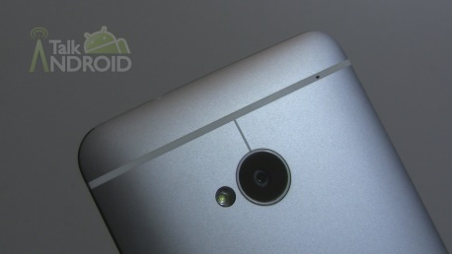
Camera API – Capture Photo Diagram
Camera Preview
surfaceCreated()
surfaceChanged()
surfaceDestroyed()
Activity
new CameraPreview(Camera)
Button Event Handler
Device Camera
Layout
FrameLayout and Button

Slide 8
New Features
Zoom (API level 8)
GPS Data
Video Snapshot (API level 14)
Face Detection (API level 14)

Slide 9
Camera2 API
Camera 1 is deprecated
Camera2 has some serious professional features for a camera app, and it's generally way faster compared to Camera1 when implemented right
API 21+ (>87%, as of July 2018) can benefit from it
But we have to make 2 logics (for devices not fully supporting and/or acting strange on Camera2)
Camera 2 works even when camera is not open.

Slide 10
Thank You

